Slide 1
NorthRiver
Data Warehouse
Goal: one trusted star schema in Databricks that answers revenue by product category, region, channel and time.
Component 1
Component 2
Component 3
Warehouse design: star schema, grain, SCD Type 2
Pipeline: ETL, Databricks Lakeflow, validation
Business output: Power BI revenue answers
Notes:
Introduce the NorthRiver scenario in two sentences, then state the goal. Add your name and course at the end.

Slide 2
Source model and fact grain
COMPONENT 1: WAREHOUSE DESIGN
PostgreSQL OLTP (northriver)
customers
products
channels
orders
order_lines
Fact grain: fact_orders
One row per order line item
A single product on a single order. Revenue is net_amount: extended amount less discount.
Source: NorthRiver data dictionary
Notes:
Five source tables feed five staging tables. The grain is the lowest level, so revenue can be sliced by any dimension without double counting. Measures: quantity_ordered, quantity_shipped, unit_price, discount_amount, extended_amount, net_amount.

Slide 3
Star schema and SCD Type 2
COMPONENT 1: WAREHOUSE DESIGN
fact_orders
Surrogate keys (_sk) link each line to customer, product, channel, order date and ship date. Measures: quantity, unit_price, discount_amount, net_amount.
dim_customer
dim_product
dim_channel
dim_date
SCD2: segment, region
SCD2: product attribute history
No SCD, overwritten in place
Static calendar, used for order and ship date
SCD Type 2 on customer and product
Each change creates a new version with effective_from, effective_to and is_current. Past orders keep the segment, category and price that applied on the order date.
Notes:
Surrogate keys link fact to dimensions. The fact load joins on the natural key and the order timestamp falling inside the validity window, so each line gets the correct historical version. Channel and date are stable lookups, so SCD2 would add cost without value.

Slide 4

ETL scripts and validation results
COMPONENT 2: THE PIPELINE
OLTP
Staging
Warehouse
5 source tables
Extract notebook
Transform and load notebooks: dimensions, then fact
Validation check | Result
Row count: staged order lines vs fact_orders | Passed: counts match
Revenue: source line total vs sum of net_amount | Passed: totals match
No fact keys missing from the dimensions | Passed: zero missing keys
One is_current row per customer and product | Passed: exactly one
Notes:
Say what each check proves: completeness, accuracy, key integrity and correct SCD2 versioning. Also mention that audit queries confirmed no silent row drops from the joins and no revenue inflation from fan-outs.

Slide 5
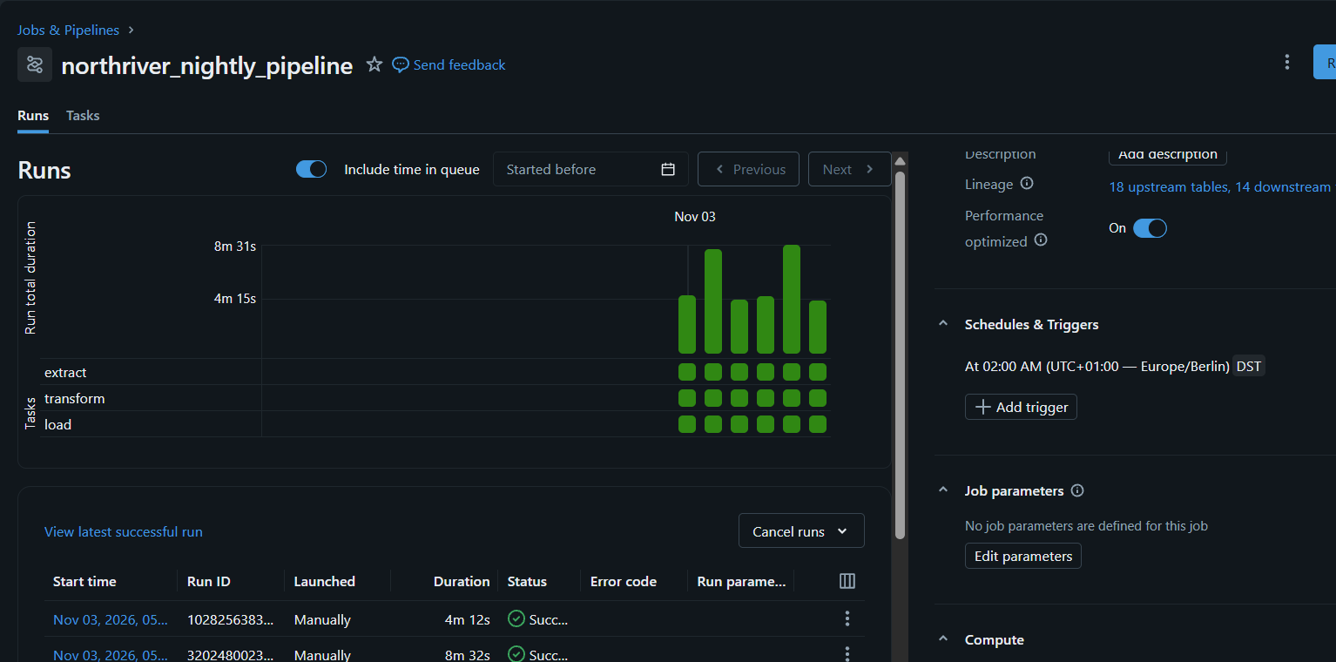
Databricks pipeline and SCD simulation
COMPONENT 2: THE PIPELINE
northriver_nightly_pipeline
Runs nightly at 02:00 (Europe/Berlin). Recent runs all succeeded.
Task order
extract, then transform (dimensions, SCD2), then load (fact_orders). The fact waits for the dimensions so surrogate keys exist.
SCD simulation
Changing one customer’s segment or region in the source and rerunning closed the old version (effective_to set, is_current false) and inserted a new current version, so history is preserved.
Notes:
Walk through the job run chart: three tasks, all green across recent runs. Then explain the simulation and show the before and after dimension rows.

Slide 6
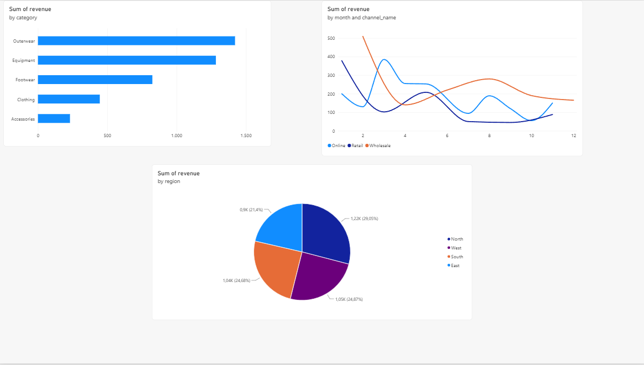
Power BI dashboard and business interpretation
COMPONENT 3: BUSINESS OUTPUT
Category
Outerwear and Equipment lead; Accessories is lowest
Region
North is largest at 29%; East smallest at 21%
Channel and time
Online, Retail and Wholesale vary by month; all fall toward year end
Notes:
Walk through one visual per question: product category, region, channel and time. Region shares are read from the pie labels. Close with the limitation and next step: dimensions sync in batches, so late-arriving orders can briefly lack a match. Next: fallback keys for unknown dimensions, schema-drift detection and customer cohort metrics.

